Slide 1

lT lnfrastructure Management
Bank System using Packet tracer
Academic year 1443 – 2022
Students :
Ghala M. Alkhaldi
Fida M. Alelou
May M. AlOtaibi
Instructors:
-L.Tagreed Balharith - TA. Maha Alghamdi

Slide 2

Content
01
02
03
04
05
06
Project idea
Used protocols
Network topology
Protocols configuration
Results and Performance of Protocols
Conclusion

Slide 3

01
Project idea
The growth trend of Internet banking brings many security issues and increases the cost of implementing a higher and high-performance security system for both Internet banking users and banks. The most important issue in Internet banking security is the protection of valuable information that is vulnerable to unauthorized access by attackers. Hence, banks must constantly increase security.

Slide 4
02
Used protocols
We've used two types of protocols that fit the idea and the network topology :
BGP :
RIP :
Responsible for looking at all the available paths that data could travel and picking the best route, that increase the security.
It will send routing-update messages at regular intervals. When a device receives a RIP routing update that includes changes to an entry, the device updates its routing table to reflect the new route.

Slide 5
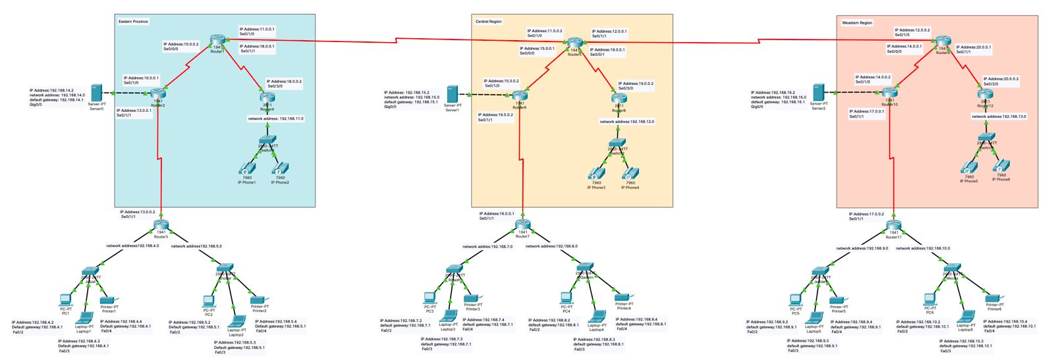
03
Network topology
Figure 1 Network topology

Slide 6

04
Protocols configuration
Configuration Routing RIP of Router 1:
Router>enable
Router#config terminal
Router(config)#router rip
Router(config-router)#version 2
Router(config-router)#network 10.0.0.0
Router(config-router)#network 11.0.0.0
Router(config-router)#network 18.0.0.0
Router(config-router)#no auto-summary

Slide 7
04
Protocols configuration
Configuration Routing BGP of Router 1:
Router>enable
Router#config terminal
Router(config)#router bgp 100
Router(config-router)#neighbor 10.0.0.1 remote-as 400
Router(config-router)#neighbor 11.0.0.2 remote-as 200
Router(config-router)#neighbor 18.0.0.2 remote-as 500

Slide 8
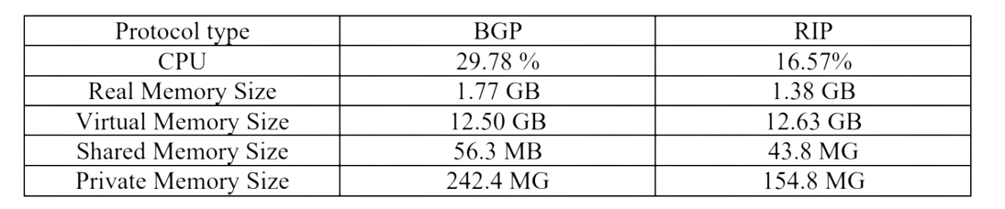
05
Results and Performance of Protocols
Based on the chosen metrics, we find that the Border Gateway Protocol consumes a higher percentage of CPU and memory than the RIP and we conclude from figure 1 that the most efficient and performance in the network is the RIP protocol.
Table 1 Performance of BGP and RIP

Slide 9



06
Conclusion
The following conclusions may be drawn based on the results:
The routing performance of RIP and BGP is excellent; after transmitting messages numerous times, RIP and BGP routing have an average packet loss of 0% The RIP routing method of using network space works effectively, resulting in quicker and more efficient information distribution Rip consumes less memory.

Slide 10
Thank You for listening

